Slide 1
Password Policy Question-Answer Service
High Level Overview

Slide 2
Basic Workflow
Word Doc
Custom pseudocode defines pages and page content.
Template
Defines static text – text that doesn’t deal with questions.
Output XML
Combines the parsed contents of the word doc with the static text from the template.
Web app takes and parses the XML code
Creates groups, questionnaire pages, and questions based on XML file.
Web pages are created via template files.

Slide 3
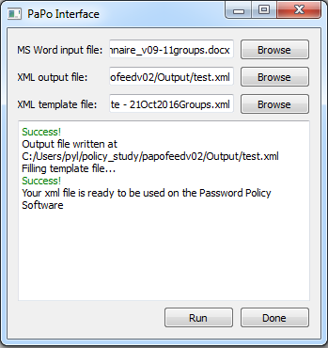
Papofeed Interface
Papo_interface.py
Creates the interface seen here.
Calls docx2xml.py on ‘Run’
Docx2xml.py
Top level
Calls and stores output from parser functions.

Slide 4
Word Doc Parser Scripts
Elements.py
Defines groups, pages, responses, comments, and other elements.
Extractor.py
Extracts text lines from the word doc
Feed.py
Creates new elements based on the contents of a line.
Toxml.py
Generates XML output file from the lists of various elements

Slide 5
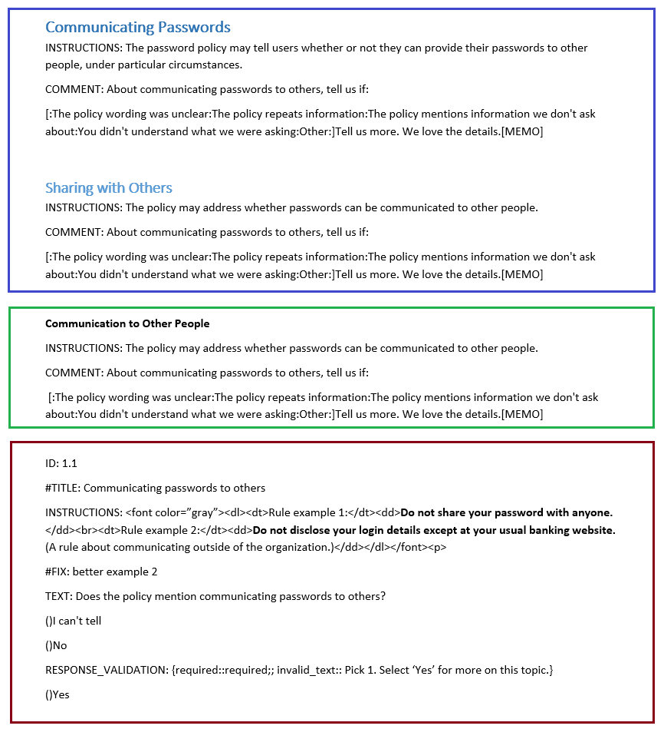
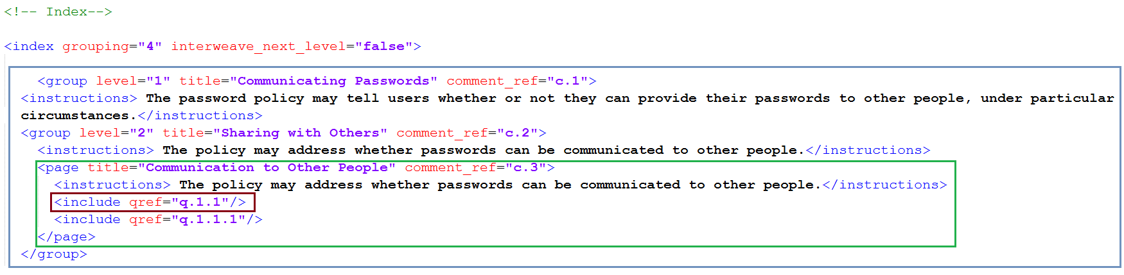
Word Doc

Slide 6
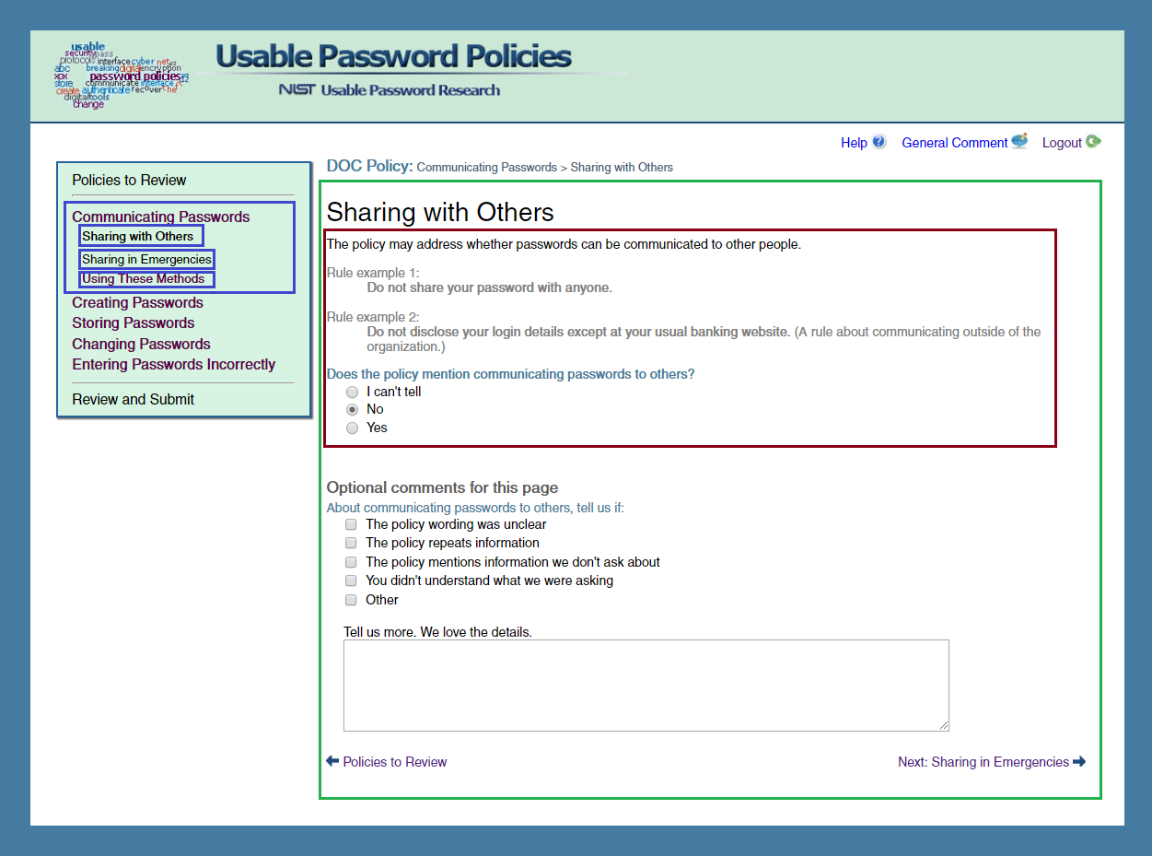

Slide 7
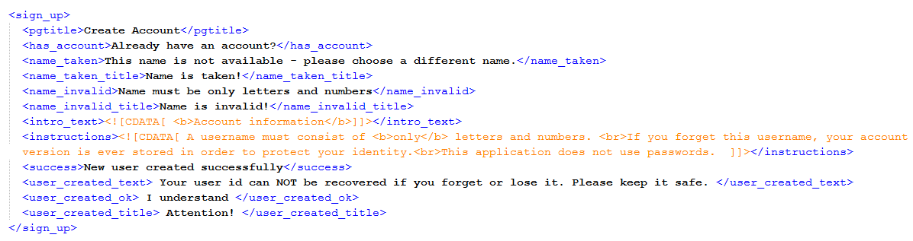
Template
Defines static text used in the web app.
Can also predefine questions + responses.
General Comments
Demographics

Slide 8
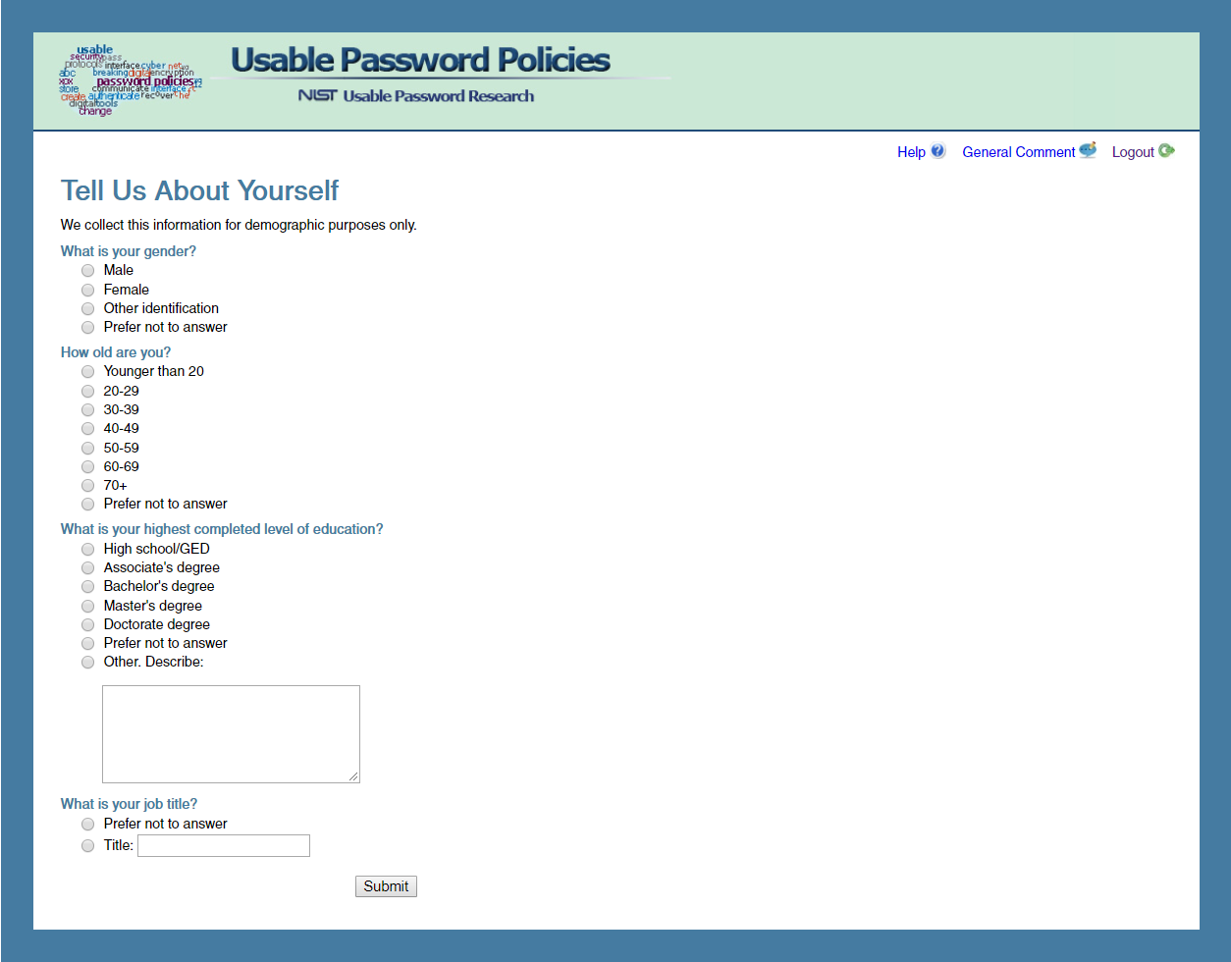

Slide 9
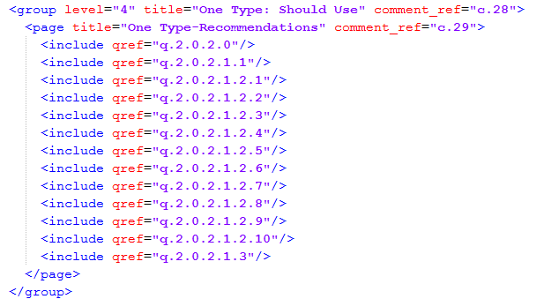
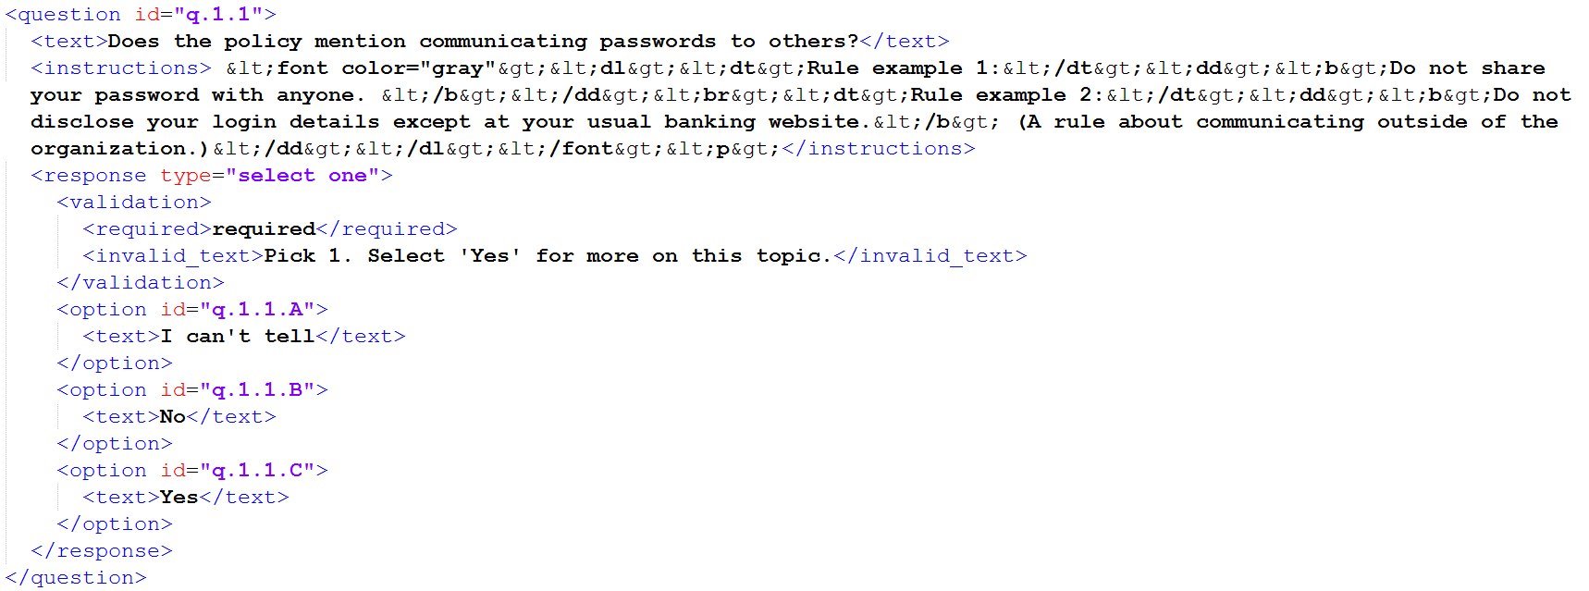
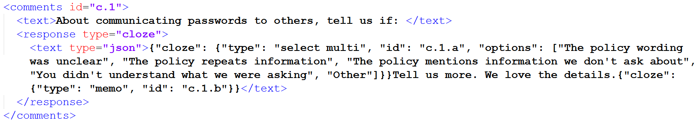
Output XML File
Contents:
Index
Questions
Comments
Template Contents

Slide 10
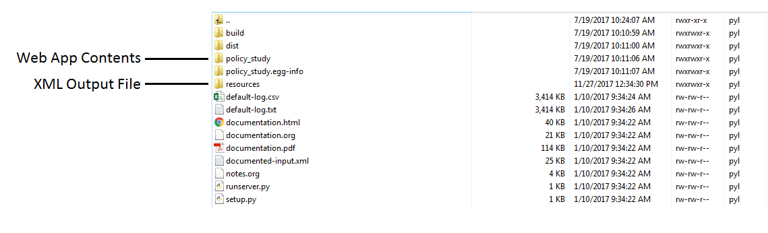
How to use output XML file
Connect to the application server (129.6.84.150, SFTP)
Move output XML file to the /resources folder.
Enter ‘python runserver.py’ to run.
Navigate to http://policyserver.ncsl.nist.gov:6500/login (6500 is the current port, can change in runserver.py)

Slide 11
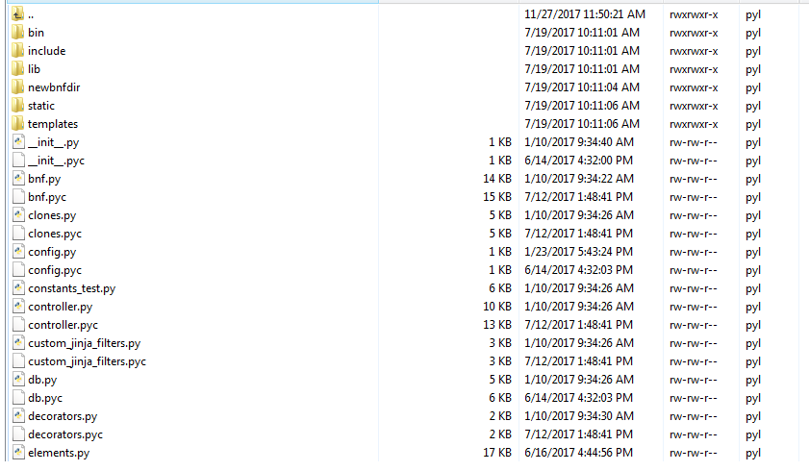
Web App Folders
Flask based
/policy_study
Python files for element behavior
Questions, Clones, BNF reports, etc.
/static
Images, CSS, JavaScript, policy images
/templates
HTML pages
Shared structure – common.html

Slide 12
Key .py files
Config.py – holds vars for various file paths
Policy PDFs, Input XML filename
Views.py - handles backend functions for each page
Account login validation, page building, pulling specific policy pdfs, etc.
Forms.py – defines classes for non-question forms
Login, Signup, Comments, etc.
Clones.py – sets up clone question information for a page
Retrieval, preparation, etc.

Slide 13
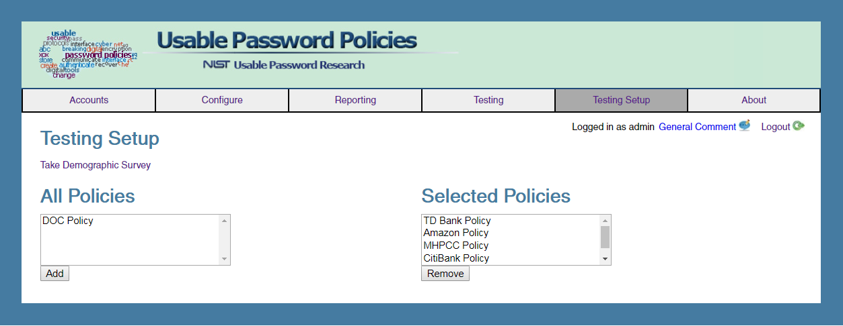
Administrative Testing
Login – admin
Password - admin

